Slide 1
ARCHITECTURAL DESCRIPTION OF KONARK TEMPLE
Konarak is a village located at a distance of 66 km from Bhubaneswar, the capital of Orissa
Konarak temple was conceived as colossal chariot drawn by a team of seven horses
temple was planned in such a way that it is fitted with twelve pairs of exquisitely decorated stone wheels
horses were conceived in such a way that the Sun God (Surya) himself drives this chariot
Beginning made in temple building activities in the 7th century A.D.-culminated in the 13th century A.D.
Built under the reign of Narasimha Deva I (AD 1238-1264)

Slide 2
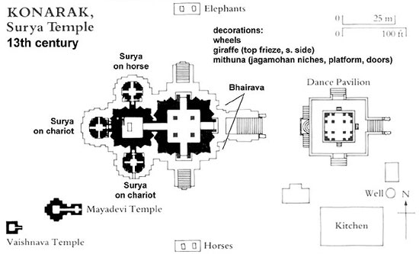

Slide 3
On the north and south sides are 24 carved wheels, each about 3 m in diameter, as well as symbolic motifs referring to the cycle of the seasons and the months.
These complete the illusionary structure of the temple-chariot.
Between the wheels, the plinth of the temple is entirely decorated with reliefs of fantastic lions, musicians and dancers, and erotic groups.
Sun Temple comprises several distinct and well-organized spatial units.
The vimana (principal sanctuary) was surmounted by a high tower with a shikhara (crowning cap), which was razed in the 19th century.
To the east, the jahamogana (audience hall) dominates the ruins with its pyramidal mass.
Farther to the east, the natmandir (dance hall), today unroofed, rises on a high platform.

Slide 4
Main Attractions
The main temple structure and the geometrical patterns all around the temple
The carved wheels and the spokes of the wheel which serve as sun dials
Architectural figures including the war horses, the elephants and the guarding lions at the entrance
The Nata Mandir (Dancing Hall)
Three images of Sun God at three direction of the temple to catch the rays of the Sun at dawn, noon and sunset
The various images of dieties, dancers, musicians, elephants and mythical creatures
The second level of the temple structure which showcases the famous erotic sculptures
The Sun temple museum run by Archaelogical Survey of India
The Nava Graha (Nine Planets) Temple

Slide 5
Facts
The Konark is the third link of Odisha's Golden Triangle. The first link is Jagannath Puri and the second link is Bhubaneswar (Capital city of Odisha)
The Konark temple is constructed as a gigantic chariot with 24 wheels about three meters high and pulled by 7 horses, housing the Sun God within
The entrance is guarded by two huge lions, each killing a war elephant and beneath the elephant is a man. The lions represent pride, elephants represent wealth and both of them consumes man
Konark temple was initially built on the sea bank but now the sea has receded and the temple is a little away from the beach.
This temple was also known as 'BLACK PAGODA' due to its dark color and used as a navigational landmark by ancient sailors to Odisha
Everyday, the Sun's rays would reach the Nata Mandir from the coast and reflects from the diamond placed at the center of the idol
A heavy magnet was placed at the temple top and every two stones of the temple is sandwiched by iron plates.
The idol was said to have been floating in air due to the arrangement of magnets. The magnet at the top is said to have disturbed compasses for coastal voyagers and later on removed

